Slide 1
Information Retrival

Slide 2
IR deals with the organisation, staorage,retrieval and evaluation of information relevant to user’s query
A user in need of information formulates a request in the form of a query written in a natural language
The retrieval system responds by retrieving the document that seems relevant to the query
IR system differs from question answering system and data retrieval system
In question answering and data retrieval system queries are specific and precise in nature

Slide 3
Queries submitted to IR system are often vague and imprecise
Question answering system provide user’s with the answer to specific question
Data retrieval system retrieve precise data organised in a well defined structure
IR system neither search for specific data nor search for direct answer

Slide 4
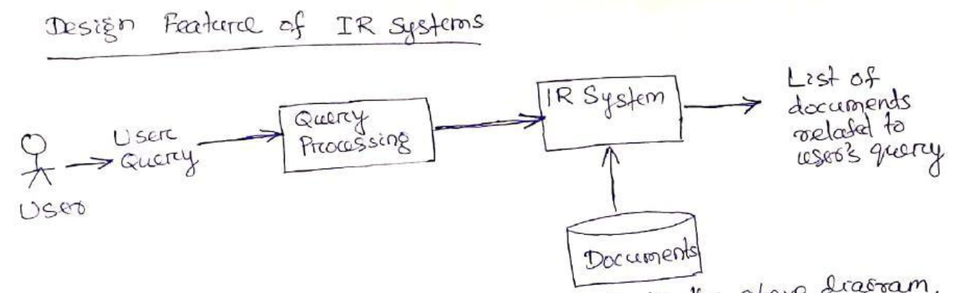

Slide 5
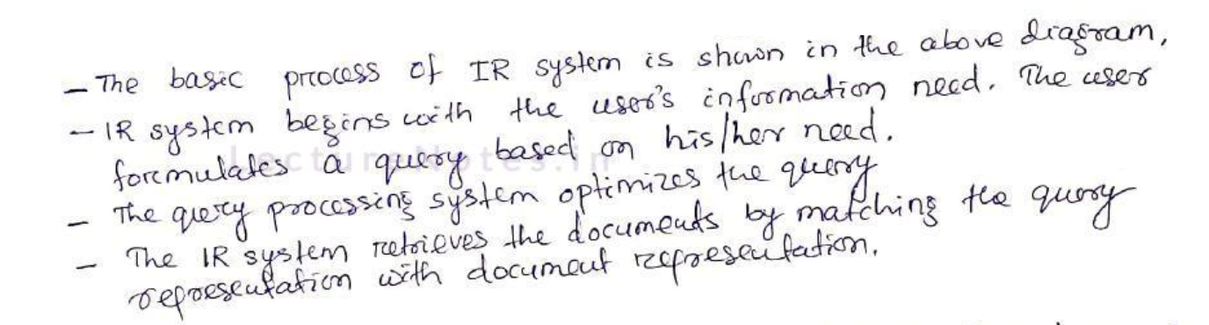

Slide 6
1. Indexing
The actual text of the document is not used in the retrieval process
Documents in a collection are frequently represented through a set of index terms or keywords
Keywords can be single word or multi word phrases
The process of transforming document text to some representation is known as indexing
The most commonly used data structure by the IR system is the inverted index
It is a list of keywords with each keyword carrying pointers to the documents containing that keyword

Slide 7

The multi word phrases can be obtained by looking at frequently appearing sequence of words, n-grams, POS tags or by applying NLP to identify meaningful phrases or handcrafting
Methods used for phrase extraction are as follows:

Slide 8
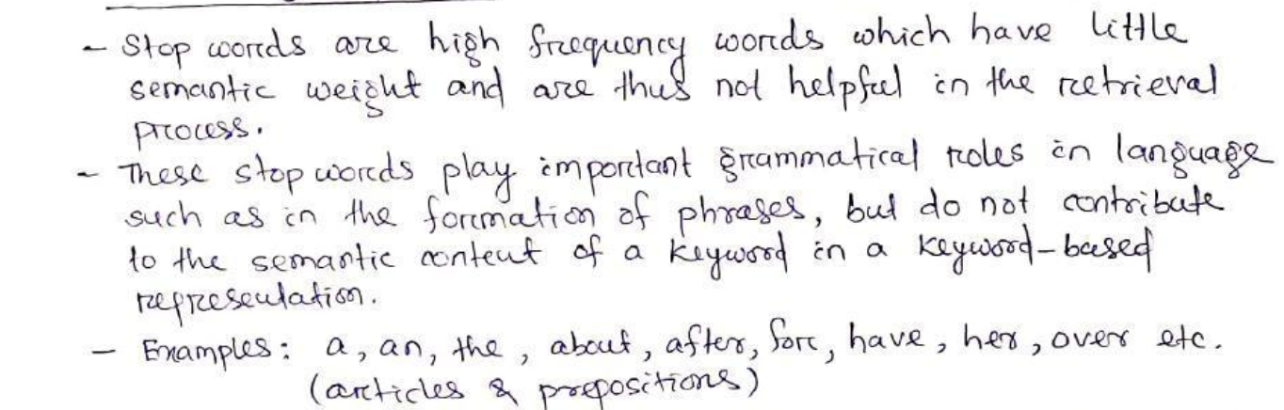
2. Eliminating stop words

Slide 9
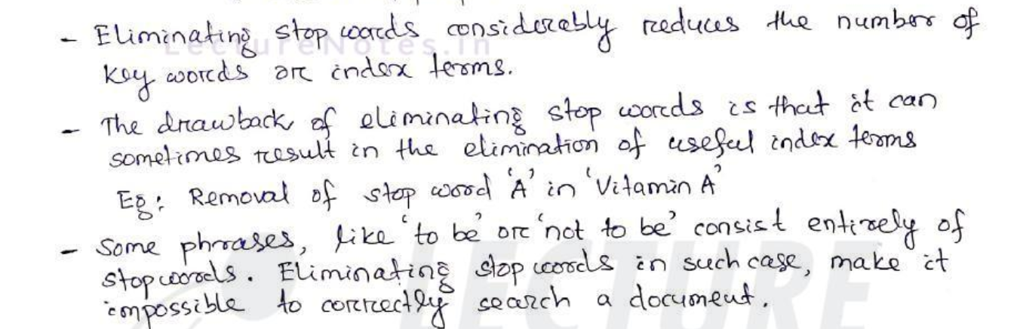

Slide 10
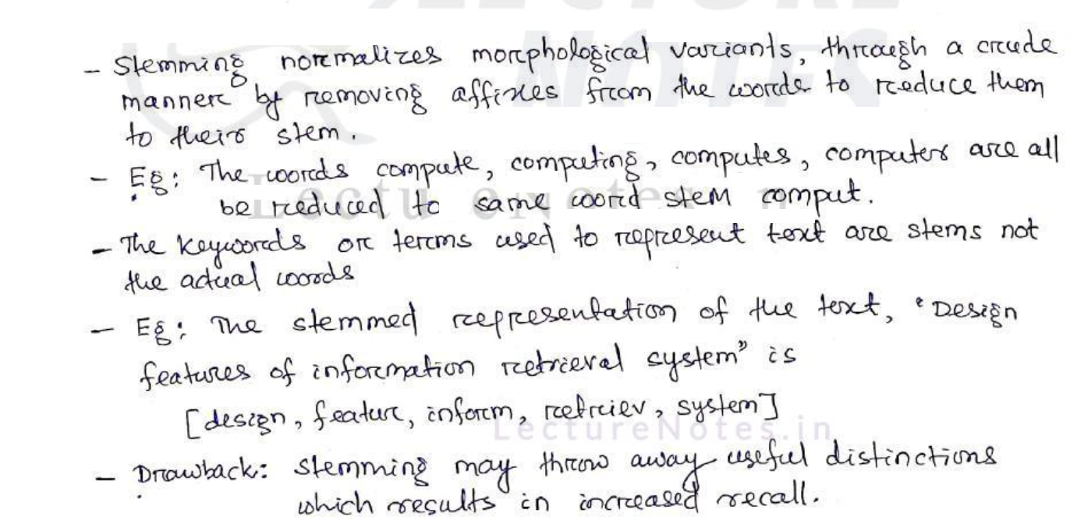
3. Stemming

Slide 11
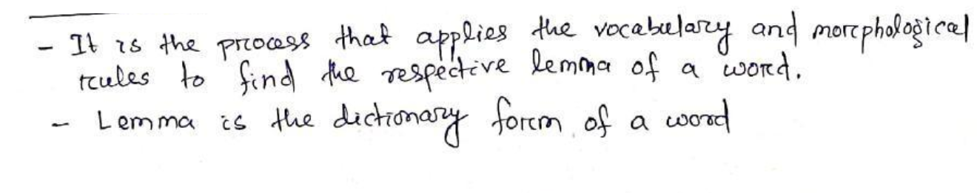
4. Lemmatization

Slide 12
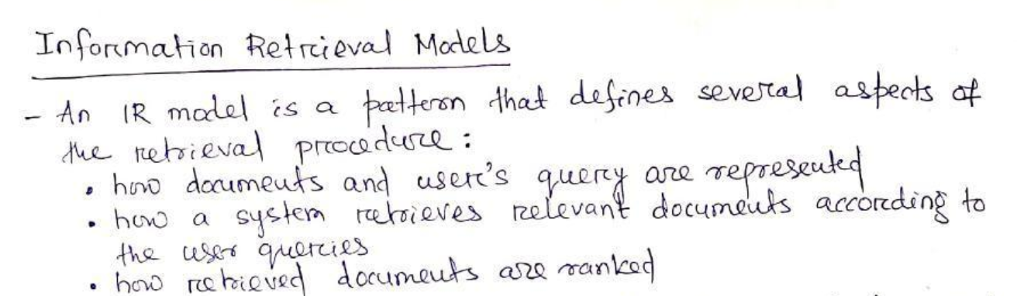

Slide 13
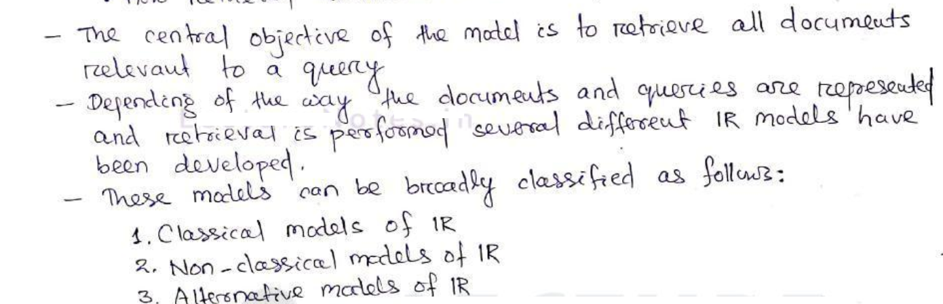

Slide 14
1. Classical models of IR
Models are based on mathematical knowledge that is easily recognised and well- understood
These models are simple, efficient and easy to implement and perform well in terms of recall and precision if the query is well formulated
Boolean model:
It is based on Boolean logic and classical set theory
The documents are represented as a set of keywords stored in a inverted file

Slide 15
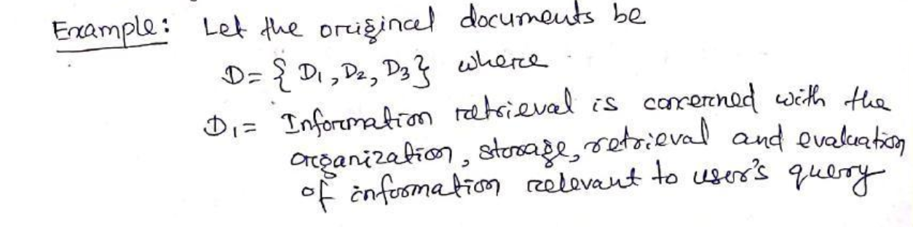
An inverted file is a list of keywords and identifiers of the documents in which they occur
User’s are required to express their queries as a Boolean expression consisting of keywords connected with Boolean logical operators (AND,OR,NOT).
Retrieval is performed based on whether or not document contains query terms

Slide 16
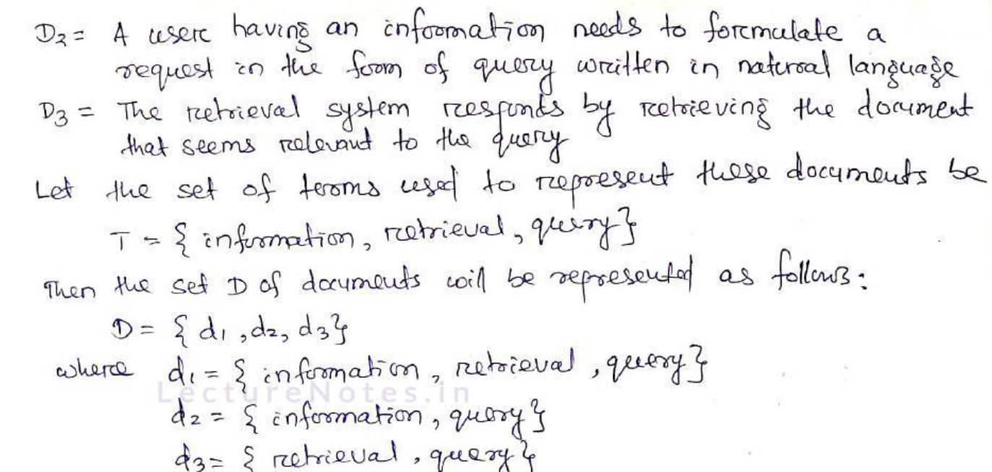

Slide 17
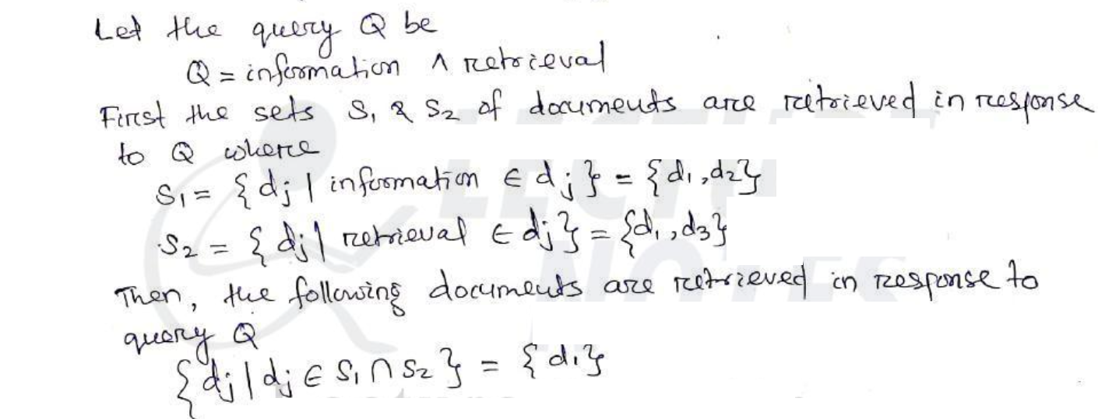

Slide 18
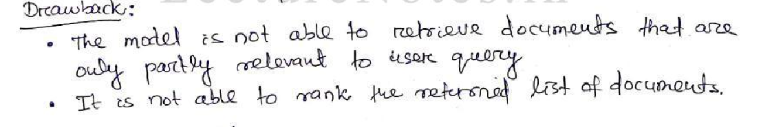

Slide 19
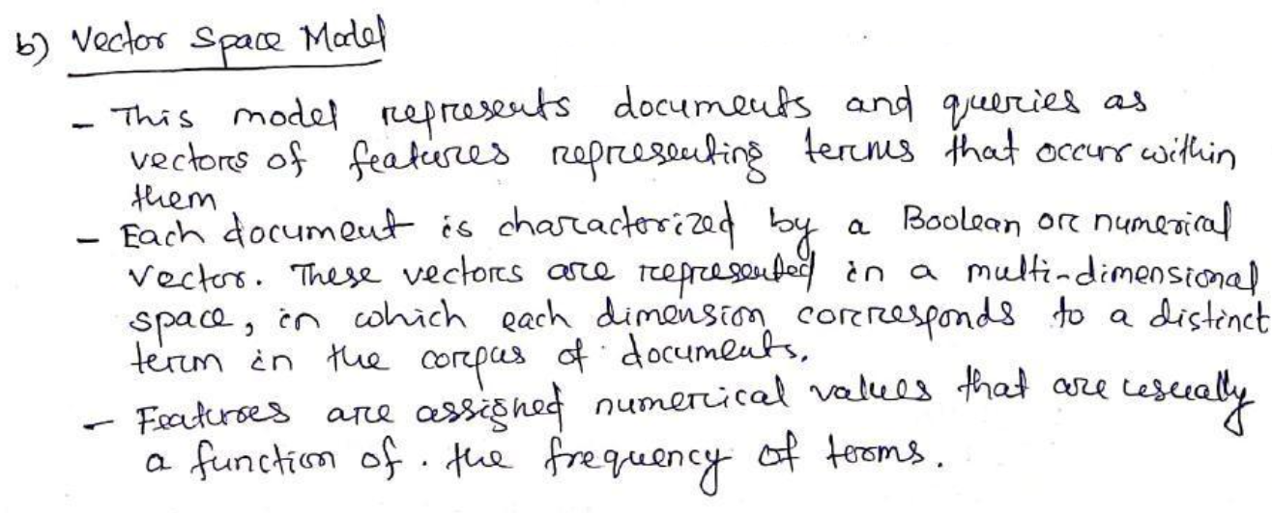
b. Vector space model

Slide 20
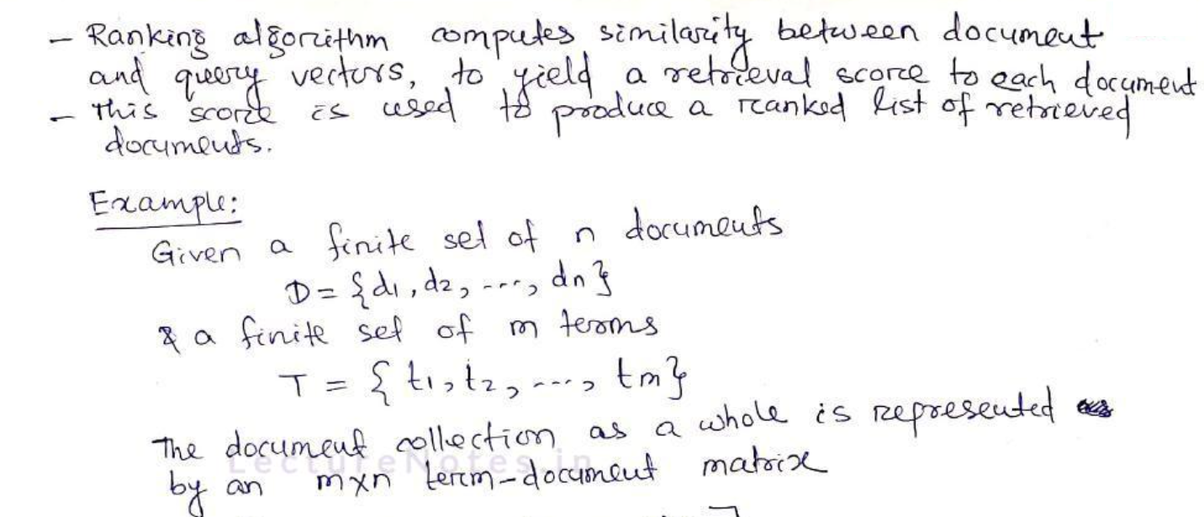

Slide 21
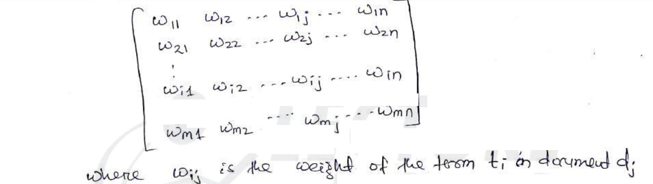
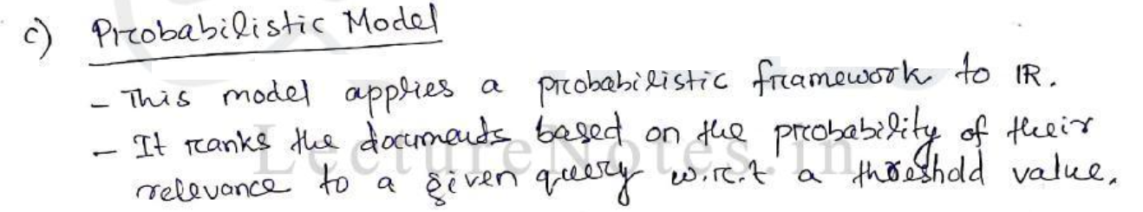

Slide 22
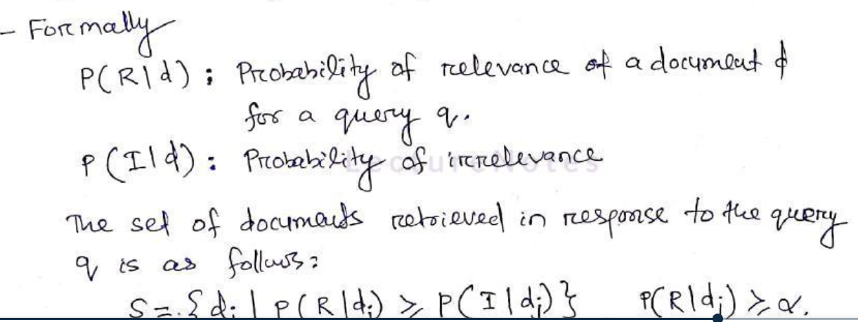

Slide 23
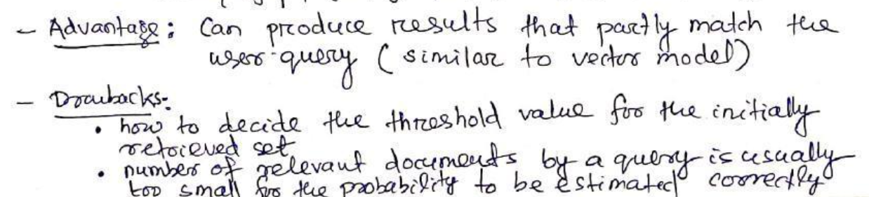

Slide 24
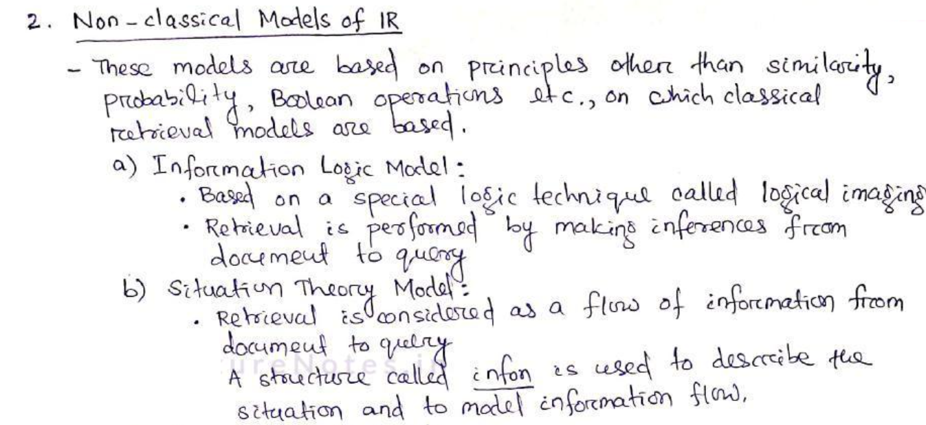

Slide 25
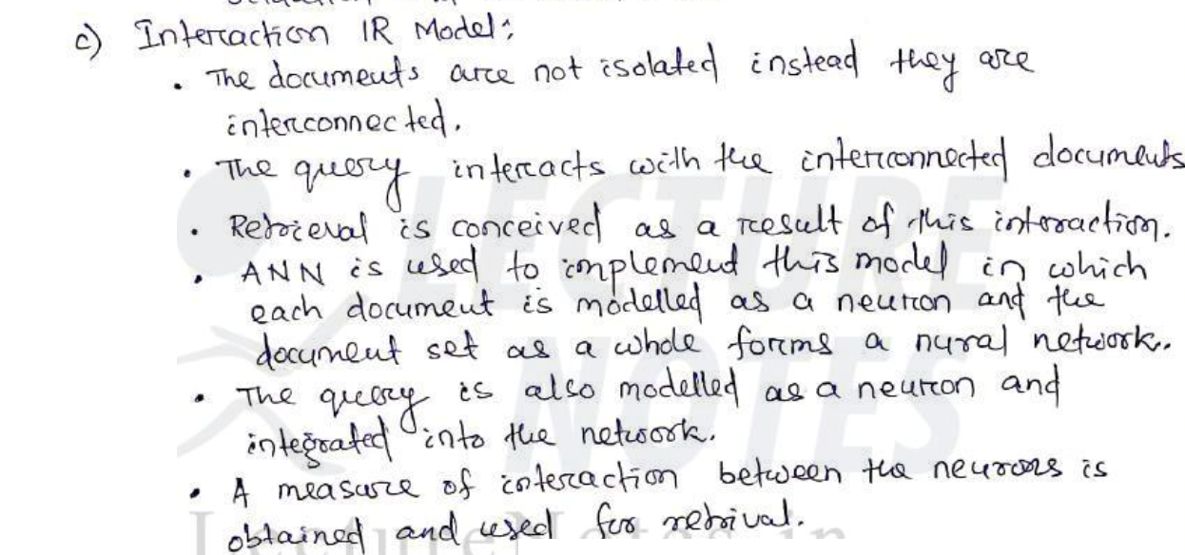

Slide 26
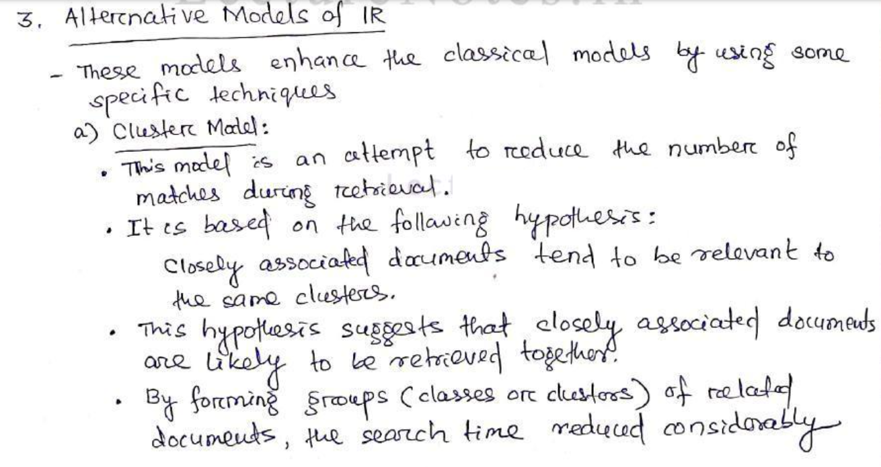

Slide 27
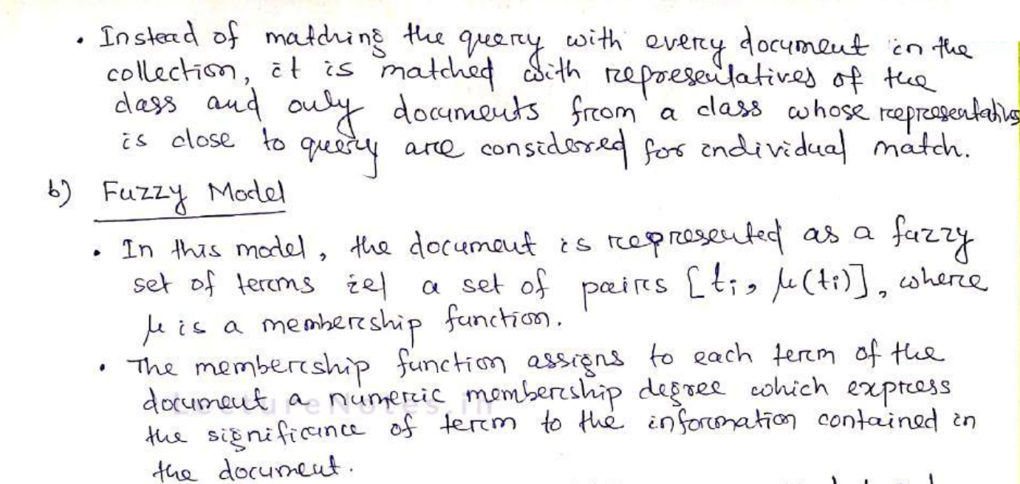

Slide 28
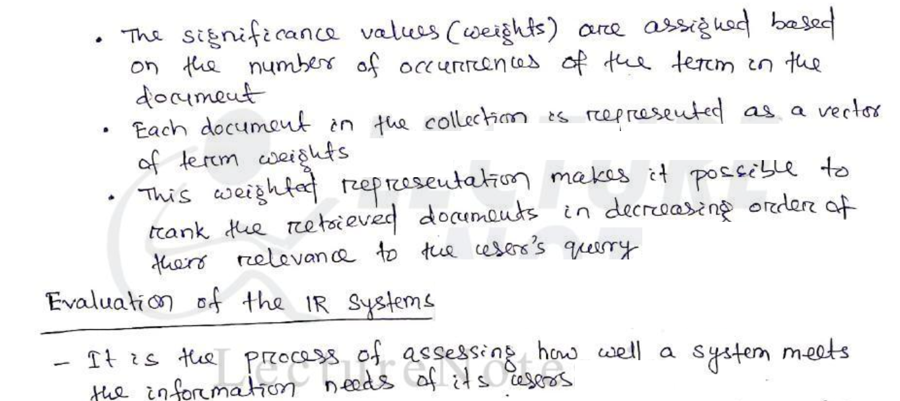

Slide 29
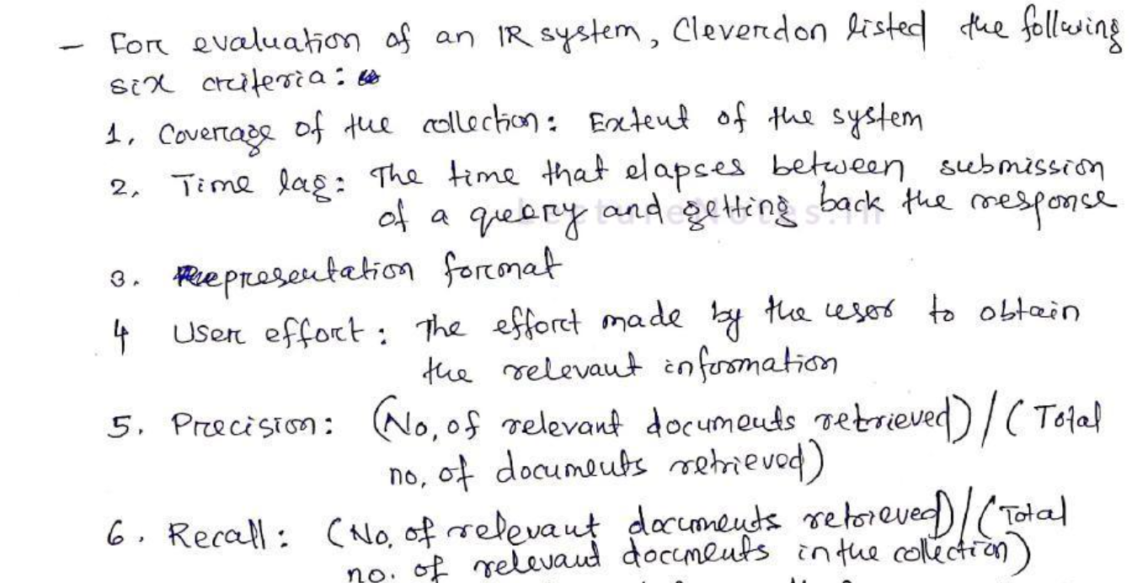

Slide 30
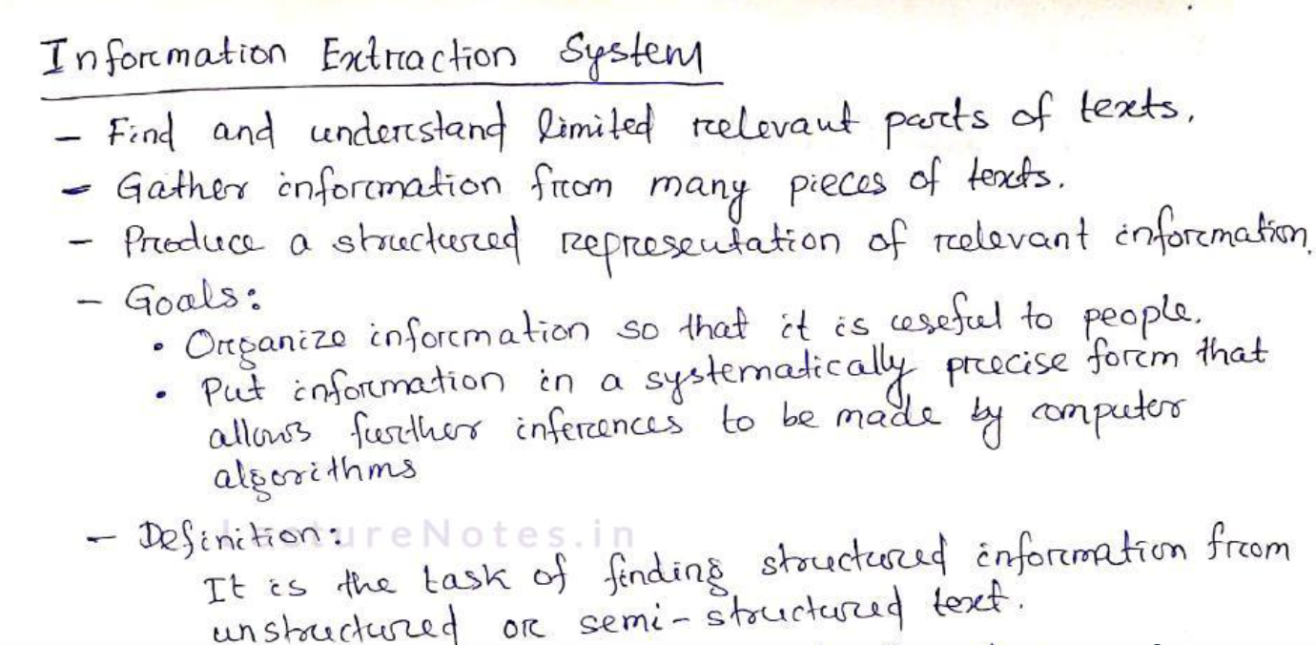

Slide 31
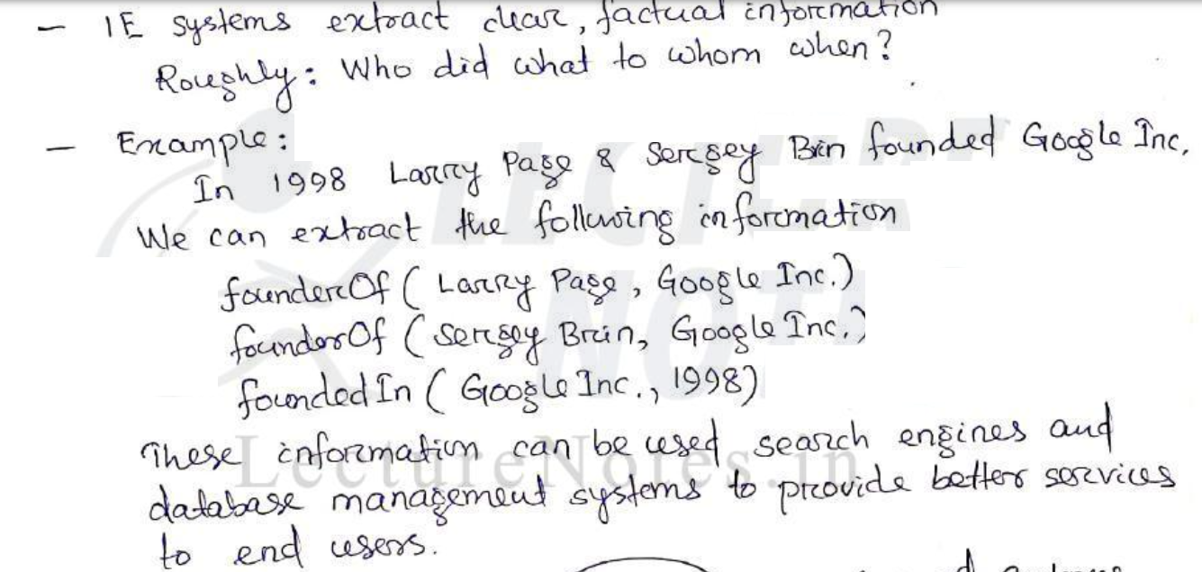

Slide 32
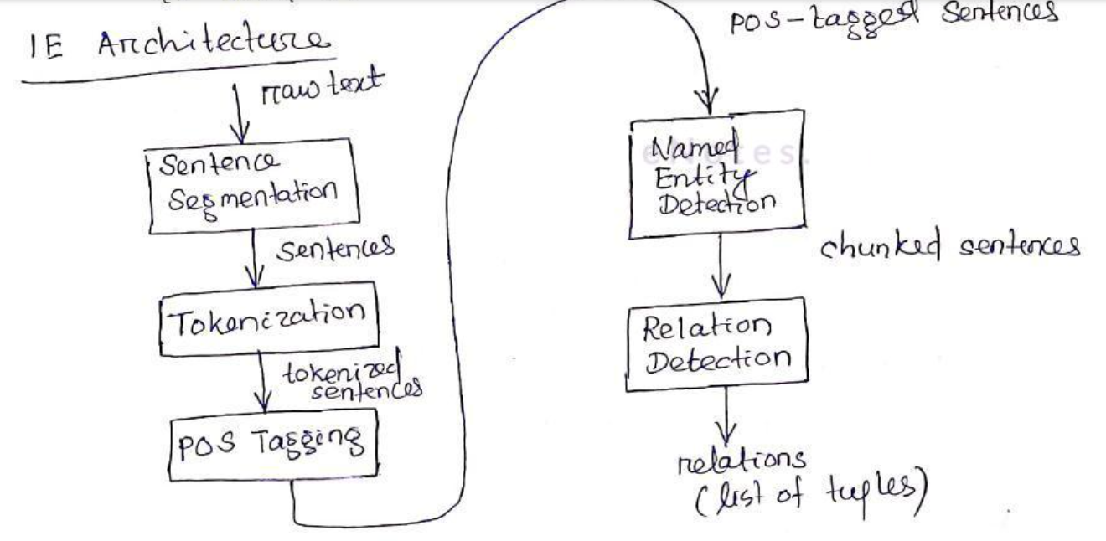

Slide 33
